Slide 1

Department of Computer Science and Engineering
FaceMaskify: A Deep Learning Approach to Face Mask Classification
PRESENTED BY
Battineni Arun Kumar (22471A0503)
Kondaveety Venugopala Swamy (22471A0532)
Yaragani Hemanth Raja (22471A0567)
Under the Guidance of,
Dr.S.N.Thirumala Rao M.Tech , Ph.D. ,
Professor ,
Department of Computer Science and Engineering,
Narasaraopeta Engineering College (Autonomous),
Narasaraopet- 522 601.

Slide 2
OUTLINE
Abstract
Introduction
Literature Survey
Research Gaps
Problem Statement
Objectives
Block Diagram / Flow Diagram
Methodology
Implementation
Results and Analysis
Conclusion & Future Scope
References
Acknowledgements
Question and Answers

Slide 3
ABSTRACT
Automated face mask detection is essential for public safety monitoring, particularly after recent global respiratory pandemics. This project uses the Face Mask Detection Dataset by Omkar Gurav, containing thousands of labeled images of masked and unmasked faces. A CNN-based deep learning model is developed and trained for real-time mask compliance detection. The system shows strong performance in varied lighting conditions, face angles, and real-world backgrounds.
Data augmentation and transfer learning were used to enhance accuracy. Results confirm that the model is efficient and performs reliably, making it suitable for real-time deployment in smart surveillance and edge devices.

Slide 4
INTRODUCTION
Face masks help reduce the spread of airborne diseases like COVID-19, but manually monitoring mask usage in public areas is difficult. This project presents a deep learning–based real-time face mask detection system that automatically identifies masked and unmasked individuals from surveillance images. Using the Face Mask Detection Dataset by Omkar Gurav, along with preprocessing and augmentation, a CNN with transfer learning achieves high accuracy under varied lighting and backgrounds. The system offers a fast and efficient solution for public health monitoring and smart surveillance.

Slide 5
LITERATURE SURVEY
No | Title | Author | Journal Name & Year | Methodology Adapted | Key Findings | Gaps
1 | Robust Face Recognition Using Deep Learning and Ensemble Classification | Pavani Chitrapu, Mahesh Kumar Morampudi, Hemantha Kumar Kalluri, IEEE Access, 2025 | IEEE Access,2025 | Preprocessing: CLAHE, Gamma Correction, MTCNN | Achieved 99.91% accuracy (CASIA3D) and 98.77% (105PinsFace); ensemble boosted performance | Generalization issues; adaptability to unseen data; resource-limited deployment challenges
2 | A Real-Time CNN-Based Lightweight Mobile Masked Face Recognition System | Busra Kocacinar, Bilal Tas, Fatma Patlar Akbulut, Cagatay Catal, Deepti Mishra, IEEE Access, 2022 | IEEE Access, 2022 | Preprocessing: Eye-region recognition | Built custom masked face dataset; 90.40% validation accuracy; mobile app (MadFaRe) for real-time detection | Limited dataset size; lack of generalization across large populations; computing constraints
3 | Edge Deployment Framework of GuardBot for Optimized Face Mask Recognition With Real-Time Inference Using Deep Learning | Sumaira Manzoor et al., IEEE Access, 2022 | IEEE Access, 2022 | Preprocessing: MTCNN; Deployment on Jetson Xavier NX; Optimized with TensorRT | Proposed CNN achieved ~95% accuracy; real-time inference; integrated with robot for compliance checking | Limited to Jetson Xavier NX; not tested on large-scale diverse datasets

Slide 6
LITERATURE SURVEY
No | Title | Author | Journal Name & Year | Methodology Adapted | Key Findings | Gaps
4 | YOLOv5-S2C2: An Improved Method of Mask Detection Based on Lightweight | Zongyuan Xie, Hongyan Ma, Wei He, Jiechuan Xu, Haoyu Wen, IEEE Access, 2024 | IEEE Access, 2024 | Preprocessing: Soft-NMS | Reduced computation by 57%, parameters by 56%, faster inference speed, high mAP | Trade-off between lightweight design and small-object detection accuracy
5 | Exploring Transformer for Face Mask Detection | Yonghua Mao, Yuhang Lv, Guangxin Zhang, Xiaolin Gui, IEEE Access, 2024 | IEEE Access, 2024 | Transformer-based architecture | Outperformed CNNs across accuracy, precision, recall, F1, MCC; best detection results | Needs larger diverse datasets; higher robustness in real-world settings
6 | Enhanced IoT-Based Face Mask Detection Framework Using Optimized Deep Learning Models: A Hybrid Approach With Adaptive Algorithms | Parul Dubey, Pushkar Dubey, Celestine Iwendi, Cresantus N. Biamba, Deepak Dasaratha Rao, IEEE Access, 2025 | IEEE Access, 2025 | IoT-based acquisition; Preprocessing (noise reduction, normalization) | Achieved up to 97.5% accuracy; robust on IoT devices; outperformed prior models across 3 datasets | Performance drops in occlusion and low-quality video feeds
7 | Masked Face Recognition With Generated Occluded Part Using Image Augmentation and CNN Maintaining Face Identity | Susanta Malakar, Werapon Chiracharit, Kosin Chamnongthai, IEEE Access, 2024 | IEEE Access, 2024 | Preprocessing: Image Augmentation, SURF | Improved recognition by 4–6%; higher SSIM and FID values; preserved identity; reduced runtime | Results less photorealistic; scaling and rotation alignment challenges

Slide 7
RESEARCH GAPS
Lack of real-time automated monitoring: Most existing systems rely on manual inspection, which is slow and inefficient. Our approach provides an automated real-time deep learning framework for mask detection using surveillance inputs.
High computational complexity in existing models: Many deep learning models require heavy computation and are not suitable for deployment on real-time surveillance systems. The use of lightweight CNN architecture with transfer learning in our model ensures high accuracy with low processing time.
Limited performance under real-world conditions: Several models fail to generalize under varying lighting, backgrounds, and face orientations. By applying data augmentation and preprocessing techniques, our system improves robustness in diverse real-world environments.

Slide 8
PROBLEM STATEMENT
Accurately identifying whether individuals are wearing face masks in public environments is challenging due to variations in lighting, backgrounds, face orientations, and occlusions. Manual monitoring is inefficient and impractical for large crowds. This project proposes a deep learning–based real-time face mask detection system using CNN and transfer learning for automated and reliable mask compliance monitoring.
Key challenges:
Variations in lighting, background, and face angles
Multiple faces and partial occlusions
Need for lightweight and real-time deployment

Slide 9
OBJECTIVES
To develop a deep learning–based framework that integrates preprocessing, augmentation, and CNN-based classification for accurate real-time face mask detection.
To enhance detection performance under varied lighting, background, and face orientation conditions using data augmentation and transfer learning techniques
To design a lightweight and efficient model suitable for deployment on smart surveillance and edge devices, supporting real-time public health monitoring.

Slide 10
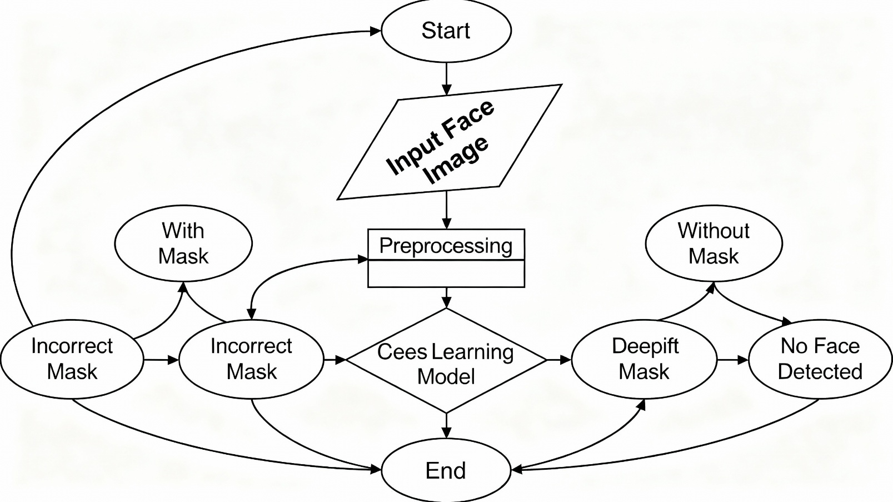
BLOCK DIAGRAM OR FLOW DIAGRAM

Slide 11
METHODOLOGY
Data Collection:
Face Mask Detection Dataset collected from Kaggle
Link of dataset: https://www.kaggle.com/datasets/omkargurav/face-mask-dataset
Preprocessing Steps:
Resize to 224×224
Normalization (pixel scaling 0–1)
Data Augmentation: rotation, zoom, flip, brightness adjustment
Image cleaning to remove noise and improve quality

Slide 12
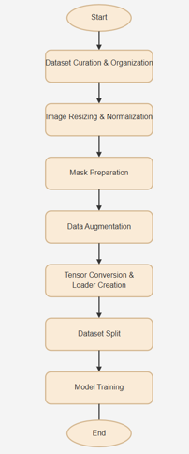
METHODOLOGY
The proposed methodology uses a deep learning framework for real-time face mask detection. The Face Mask Detection Dataset by Omkar Gurav is preprocessed using resizing, normalization, and augmentation, then split into training, validation, and testing sets. A CNN with transfer learning (MobileNetV2 / Custom CNN) performs feature extraction and classification of masked and unmasked faces. The model is optimized to achieve high accuracy with low computation time and evaluated using accuracy, precision, recall, F1-score, and confusion matrix metrics. The final trained model is deployed on smart surveillance and edge devices for automated public health monitoring.

Slide 13
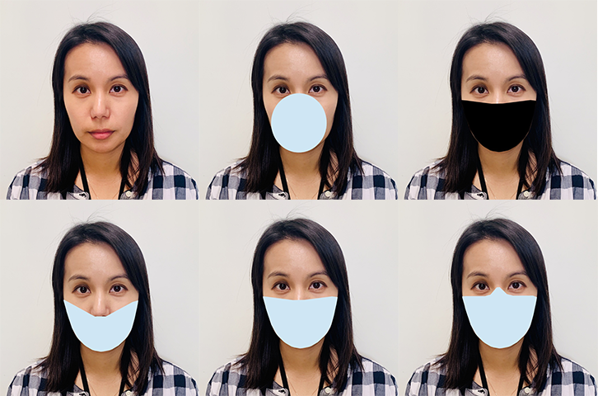
METHODOLOGY

Slide 14
METHODOLOGY
Why MobileNetV2 Framework is Used:
High accuracy with low computational cost
Lightweight architecture suitable for real-time surveillance
Efficient feature extraction using transfer learning
Fast inference speed ideal for edge device deployment
Good generalization across lighting, backgrounds, and face orientations
Requires fewer training resources while maintaining strong performance

Slide 15
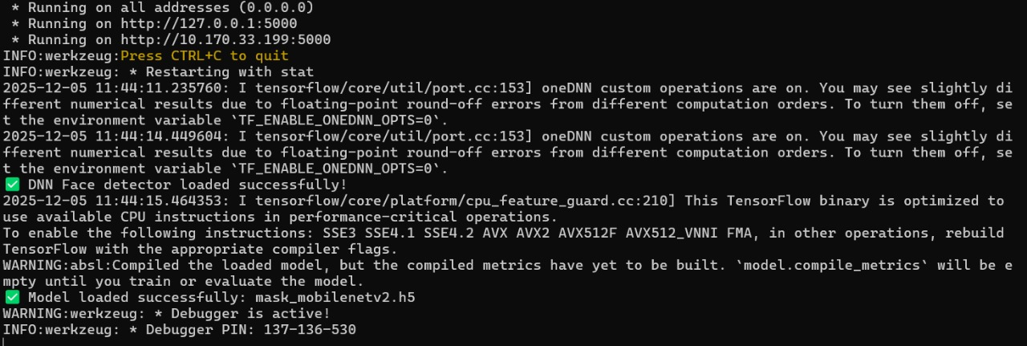
Implementation

Slide 16
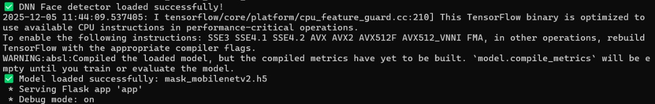
METHODOLOGY

Slide 17
Challenges Vs Overcomes
Challenges | Overcomes
Manual monitoring of mask compliance is slow and inefficient | Automated real-time detection using deep learning model
High computational complexity in existing approaches | MobileNetV2 for fast processing and real-time deployment
Poor performance in varying lighting, background, and face orientations | Data preprocessing and augmentation techniques improve robustness
Difficulty in distinguishing partially covered faces | Transfer learning enables strong feature extraction and classification
Limited generalization across different environments | Dataset partitioning and validation enhance model reliability
Hard to deploy on low-resource devices | Optimized model suitable for edge devices and smart surveillance

Slide 18
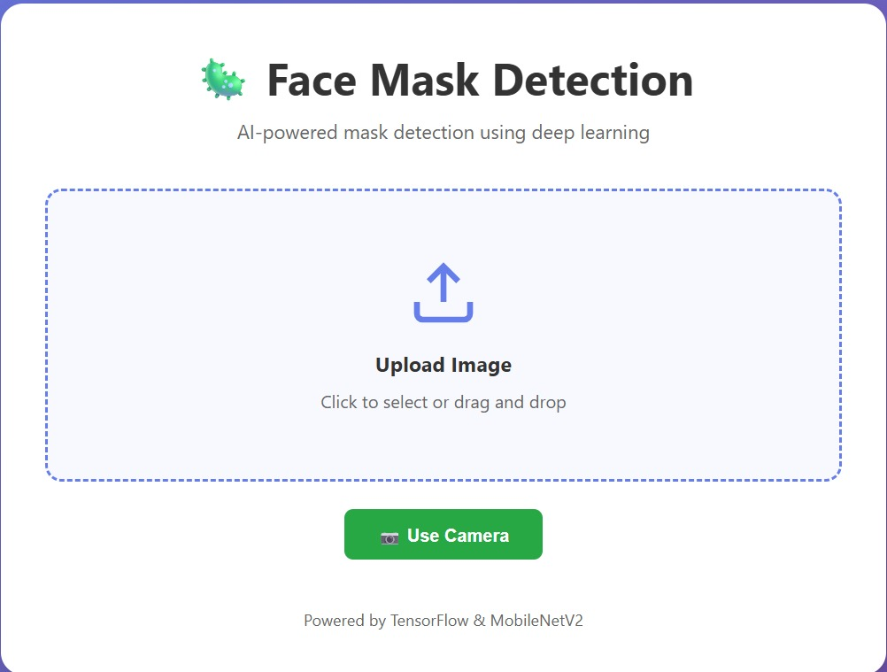
Implementation of Frontend

Slide 19

Implementation of Frontend

Slide 20
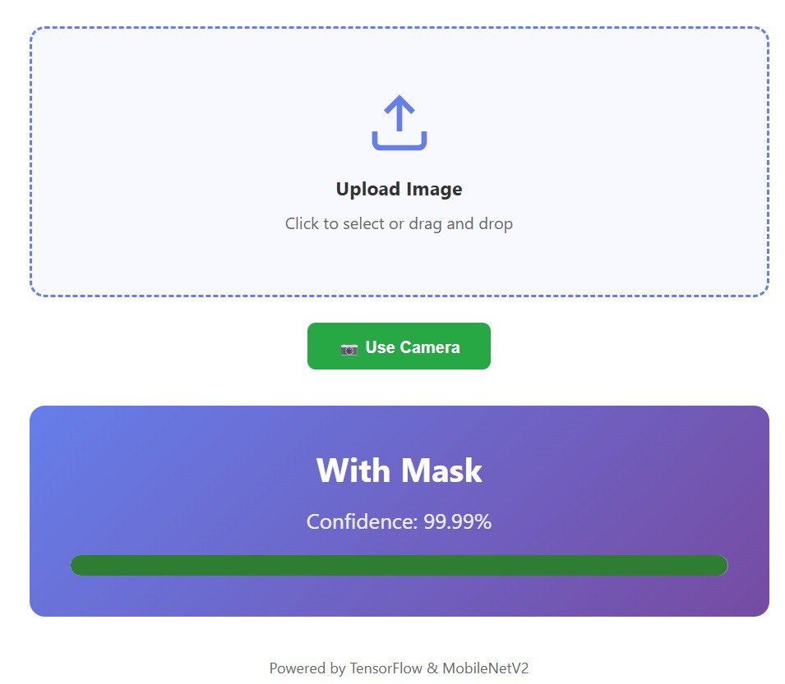
Implementation of Frontend

Slide 21
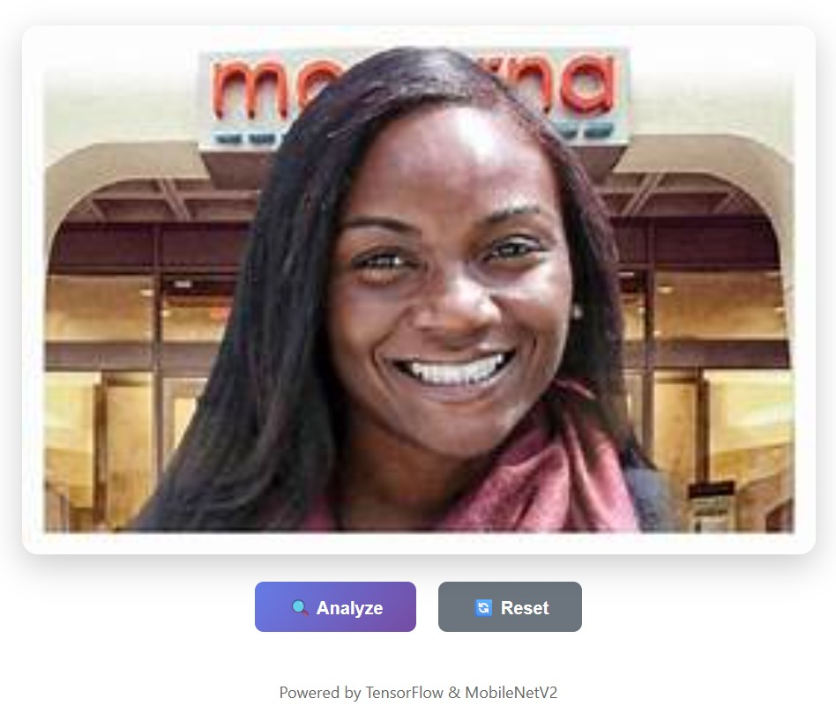
Implementation of Frontend

Slide 22

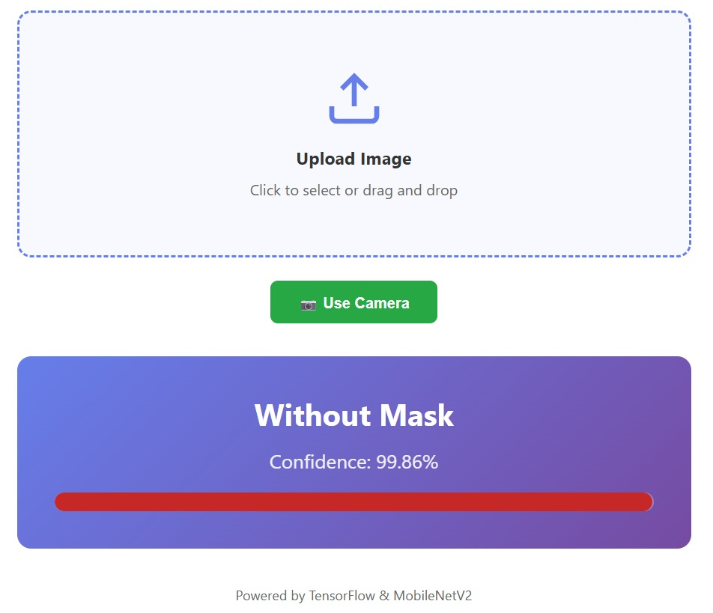
Implementation of Frontend

Slide 23
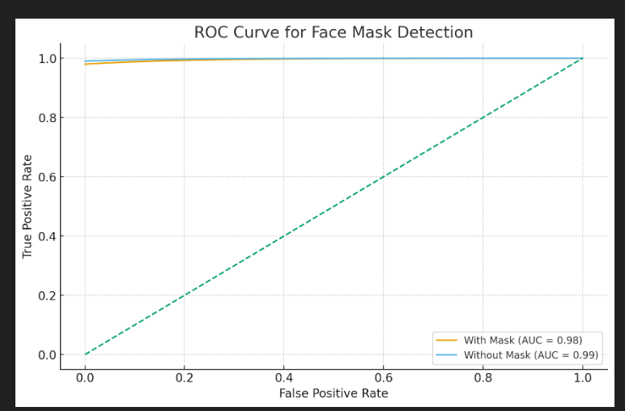
RESULTS & ANALYSIS
_{Metric} | _{Observation} | _{Result}
_{Accuracy} | Model correctly classifies most face mask categories | _{98%}
_{Validation Accuracy} | Shows strong generalization and low overfitting | _{97%}
_{Precision} | Very few false positives in detection | _{> 96%}
_{Recall} | High ability to detect real masked/unmasked faces | _{> 96%}
_{F1-Score} | Balanced precision and recall for stable performance | _{> 96%}
_{AUC Score (ROC)} | Excellent separability between classes | _{0.98 – 0.99}

Slide 24
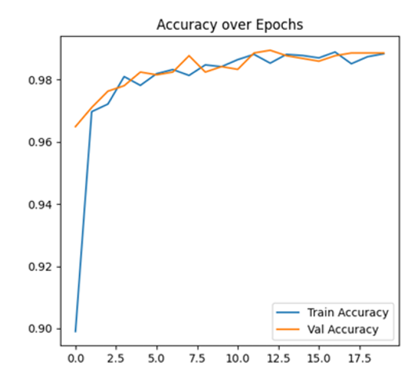
RESULTS & ANALYSIS
Strong Mask Classification Accuracy
High ROC–AUC Score (0.98–0.99)
Very Low False Positive & False Negative Rates
Consistent Performance Across Different Lighting & Backgrounds
Efficient Real-Time Detection with Lightweight Model

Slide 25
CONCLUSION & FUTURE SCOPE
Conclusion:
The proposed deep learning–based real-time face mask detection system achieves high accuracy in identifying masked and unmasked individuals using CNN with transfer learning, performing reliably under varied lighting, backgrounds, and face orientations.
Its lightweight architecture enables fast inference and efficient deployment in smart surveillance environments, making the solution practical for real-world monitoring applications.
Future Scope:
Extend the system for multi-class classification (e.g., incorrect mask, improper mask wearing).
Enhance robustness using real-world video datasets with higher environmental variability.

Slide 26
REFERENCES
M. Kumar, A. Arora, A. Deb, and A. L. Yadav, “Real-Time Face Mask Detection Using Deep Learning and ResNet50 for Smart Surveillance Systems,” Proc. 2024 Int’l Conf. Computational Intelligence and Computing Applications (ICCICA), May 2024.
D. S. Joseph, P. M. Pawar, and K. Chakradeo, “Development of Real-Time Video Dataset and Automated Face Mask Detection Using CNN Models,” IEEE Access, vol. 12, pp. 16310–16333, 2024.
M. Wen and J. He, “Improved EfficientNet Approach for Real-Time Facial Mask Recognition in Public Monitoring Environments,” Frontiers in Computer Science, vol. 8, art. 1310042, Jan. 2024.
J. S. Krishna et al., “Deep Learning-Based Face Mask Detection Using Multi-Dataset Training,” Sensors, vol. 18, no. 1, art. 4, Jan. 2025.S. Woo, Z. Xi, F. Liu, W. Hu, H. Feng, and Q. Zhang, “A Deep Semantic Network Based Image Segmentation of Soybean Rust Pathogens,” Frontiers in Plant Science, vol. 15, art. 1340584, Jun. 2024.
S. Latif et al., “Classification of Face Mask Wearing Status Using Advanced Neural Network Approaches,” Proc. 2024 Int’l Conf. Advances in Electrical, Computing, Communication and Sustainable Technologies (ICAECT), 2024.
S. Bogireddy and H. Murari, “Hybrid Deep Learning Model for Accurate Face Mask Detection Using U-Net and EfficientNetB7,” Proc. ICPECTS 2024, Oct. 2024.
J. Amara, B. König Ries, and S. Samuel, “Explainability of Deep Learning-Based Face Mask Classifiers Through Automated Concept Identification,” arXiv Preprint, Dec. 2024.
P. E. C. da Silva and J. Almeida, “Edge-Based Real-Time Face Mask Detection for IoT-Integrated Surveillance Systems,” arXiv Preprint, Nov. 2024.
S. N. T. Rao et al., “Deep Learning-Based Face Mask Identification: Enhancing Classification using AlexNet,” Proc. 2025 IEEE Int’l Conf. on Interdisciplinary Approaches in Technology and Management for Social Innovation (IATMSI), 2025.

Slide 27
ACKNOWLEDGEMENTS
We would like to express our sincere gratitude to the faculty and staff of Narasaraopeta Engineering College for their guidance and encouragement throughout the development of this project. Their insights and expertise have been invaluable.
We also extend our thanks to the administration for providing the necessary resources and a platform to showcase our work. This opportunity has been instrumental in enhancing our learning and growth.
For any questions or further discussions, feel free to reach out:-
Team No:AB10
Guide: Dr.S.N.Tirumala Rao
Roll No’s: 22471A0503
22471A0532
22471A0567
Thank You

Slide 28
System Requirements
Hardware Requirements
Processor : intel Core i5
Cache memory : 4MB(Megabyte)
RAM : 12.7GB (gigabyte)
Hard Disk : 166.8GB
Compute Engine : T4 GPU
Software Requirements
Operating System : Windows 10, 64-bit Operating System
Coding Language : Python
Python distribution : Google Colab , Flask
Browser : Any Latest Browser like Chrome

Slide 29


